Slide 1


CSE332
Industrial Ethics and Legal Issues
Ethical Behavior of IT Professional

Slide 2
ETH ICS IN INFORMATION TECHNOLOGY
Here are some examples that raise public concern about the ethical use of information technology:
Ethical concerns in technology's workplace use.
Copyright violation harms music and films.
Spam emails enable low-cost marketing.
Hacking, plagiarism, and tracking persist. ​

Slide 3

Profession
A profession is a calling that requires specialized knowledge and often long and intensive academic preparation.
Professional ?

Slide 4
Professional Employee
One who is engaged in the performance of work .
Specialized intellectual instruction.
Exercise of discretion and judgement.

Slide 5


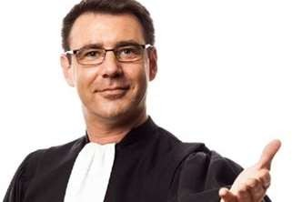
Professionals such as doctors, lawyers, and accountants require advanced training and experience; they must exercise Carefulness and judgment in the course of their work.

Slide 6
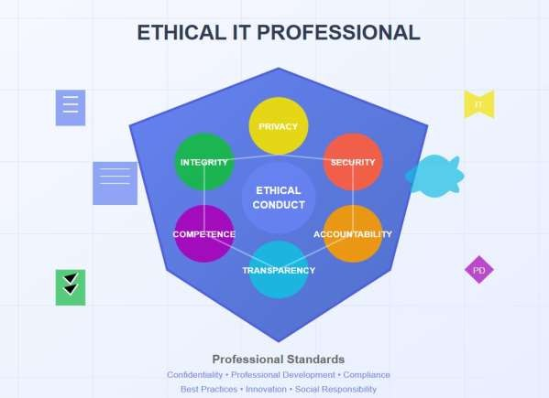

Are IT Workers Professionals?
Specialized Knowledge
Ethical Behaviour
Accountability
Commitment to Continuous Learning

Slide 7
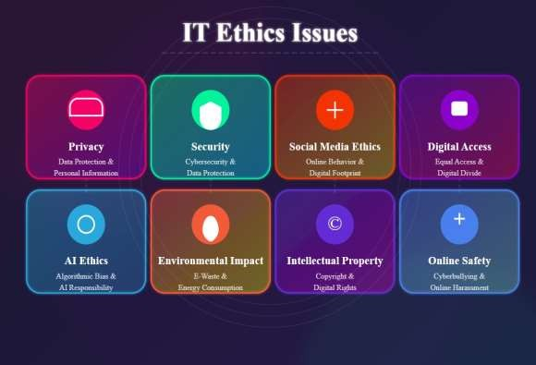
Common Ethical Issues For IT Users
Privacy Concern
Cybersecurity Risks
Misuse of IT Resource
Surveillance and Monitoring

Slide 8
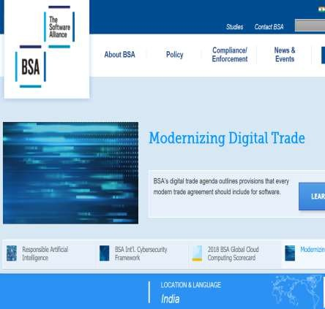
Business Software Alliance (BSA)
The Business Software Alliance
(BSA) is
represents
software
a trade group that the world’s largest and hardware
manufacturers.
Its mission
is to stop the copying of its
unauthorized
software
members.
produced by

Slide 9
More than 100 BSA lawyers and investigators prosecute thousands of cases of software piracy each year.
BSA investigations are usually triggered by calls to the BSA hotline, reports sent to the BSA Web site (www.nopiracy.org), and referrals from member companies.

Slide 10

Supporting the Ethical Practices Of IT
Users
Education And Awareness
Clear Policies and Standards
Access Control and Security
Ethical Use Of AI And Automation
Collaboration and community Involvement

Slide 11
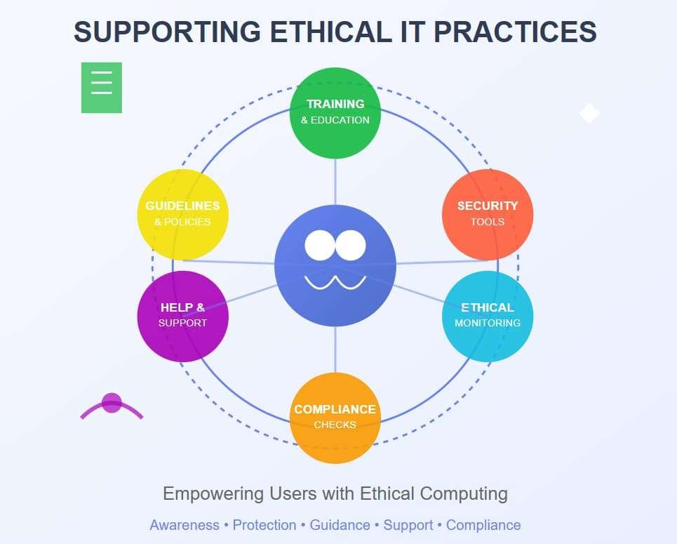
Supporting the Ethical Practices

Slide 12
Q1. What is the primary role of ethical behavior in IT? a) Profit maximization b) Protecting users' privacy and data c) Increasing sales d) Reducing software costs
Notes:
b

Slide 13
Which organization is known for combating software piracy? a) IEEE b) Business Software Alliance (BSA) c) ACM d) WTO
Notes:
b

Slide 14
What is the main ethical issue in AI and automation? a) High production cost b) Privacy and data bias c) Fast decision-making d) Lack of performance
Notes:
b

Slide 15
An employee uses office resources for personal social media browsing during work hours. What ethical principle is violated? a) Privacy b) Copyright violation c) Misuse of IT resources d) Surveillance
Notes:
c

Slide 16
Scenario 1: A software company collects user data without informing the users. The data is used to improve product performance. Question: What ethical principle is violated in this situation? a) Transparency b) Accountability c) Privacy d) Efficiency
Notes:
c

Slide 17
Scenario 2: An IT firm stores customer passwords in plain text without encryption. A data breach exposes these passwords. Question: What best practice should have been followed to prevent this issue? a) Data masking b) Two-factor authentication c) Encryption d) Access control
Notes:
c

Slide 18
A healthcare startup develops an AI tool to predict diseases. However, the training data includes only male patients, making the predictions biased against female patients. Question: What action should the company take to correct the ethical issue? a) Ignore the issue b) Collect diverse training data c) Remove the AI tool from the market d) Increase AI speed
Notes:
b

Slide 19
A software development firm aims to promote women in leadership roles. They have 20% women employees but no women in leadership positions. Question: Which initiative would best promote women empowerment? a) Increasing work hours b) Offering leadership training programs for women c) Hiring only male managers d) Reducing female recruitment
Notes:
b

Slide 20
What is the primary responsibility of an IT professional regarding customer data? a) Selling data to third parties b) Protecting the privacy of customer data c) Ignoring data breaches d) Encrypting only sensitive data
Notes:
b

Slide 21
An employee installs pirated software on the company’s computer. Which ethical issue does this represent? a) Cybercrime b) Plagiarism c) Software piracy d) Privacy violation
Notes:
c

Slide 22
What is the most appropriate method for ensuring data privacy in cloud storage systems? a) Public Wi-Fi usage b) Data encryption c) Installing antivirus only d) Using common passwords
Notes:
b

Slide 23
What is the primary objective of women empowerment initiatives in STEM fields? a) Gender diversity b) Cost reduction c) Limiting female participation d) Profit maximization
Notes:
a

Slide 24
Which of the following policies best supports women empowerment in the workplace? a) Equal pay and flexible work hours b) Hiring only male employees c) Reducing maternity leave d) Offering only managerial positions
Notes:
a

Slide 25
What is the primary goal of the Business Software Alliance (BSA)? a) Promote free software b) Encourage software piracy c) Stop unauthorized software copying d) Provide open-source software
Notes:
c

Slide 26
A software company develops a language translation app that gives inaccurate translations for minority languages.
Question: What should the company do to resolve the ethical issue? a) Continue selling the app b) Collect diverse language datasets c) Ignore user complaints d) Advertise only for popular languages
Notes:
b

Slide 27

NEXT TOPIC:
Women Empowerment
Ethical Aspects of Engineering Practices

